Slide 1
Virtual Canvas
Submitted by:-
Sagarika Padhy
MCA 3rd Sem
Regd.No.: 2006151006

Slide 2
Content
Introduction
Objective
Features
Functionalities
System Configuration
Diagrams
Output Screen

Slide 3
Introduction
In this project, Virtual Canvas we can draw anything on it by just capturing the motion of a colored marker with a camera. Here a colored object at the tip of the finger is used as the marker.

Slide 4
Objective
The Main Objective of this project is to provide a canvas to the user by using which user can draw anything on it just by moving the hand in air.
It provides facility to choose colour and also to clear the screen.

Slide 5
Features
Can track any specific colored pointer .
User can draw in four different colors and even change them without any hussle.
Able to rub the board with a single location at the top of the screen.
No need to touch the computer once the program is run

Slide 6
Functionality
Read frames from a webcam
Create the canvas window
Detect the green color
Draw on the canvas

Slide 7
System Configuration
Software Required
Hardware Required
Processor : Intel Quad-core
RAM : 8GB
Monitor : Any colour monitor
Web Cam
python3
numpy
opencv

Slide 8
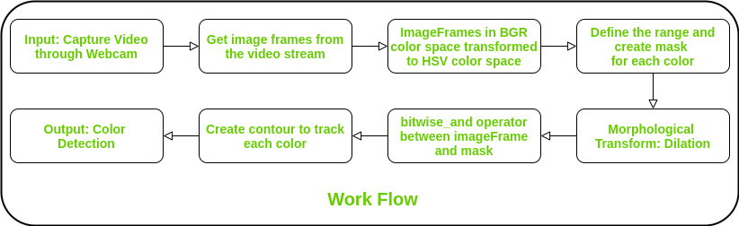
Diagram

Slide 9
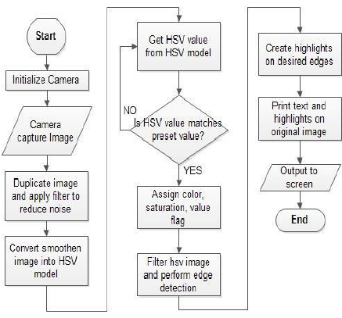
Flow Chart

Slide 10
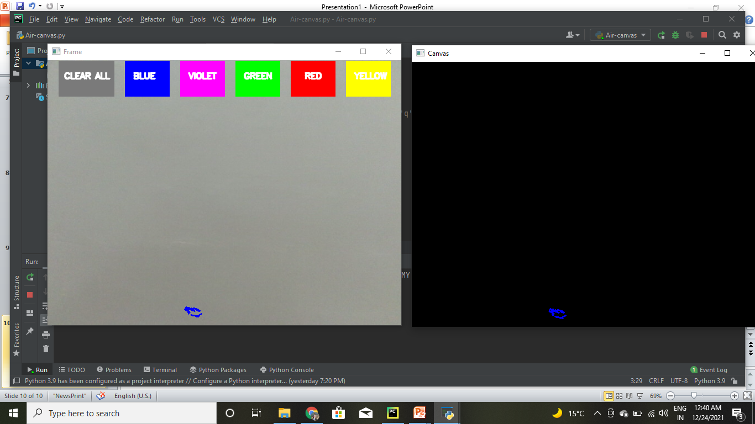
Output Screen

Slide 11
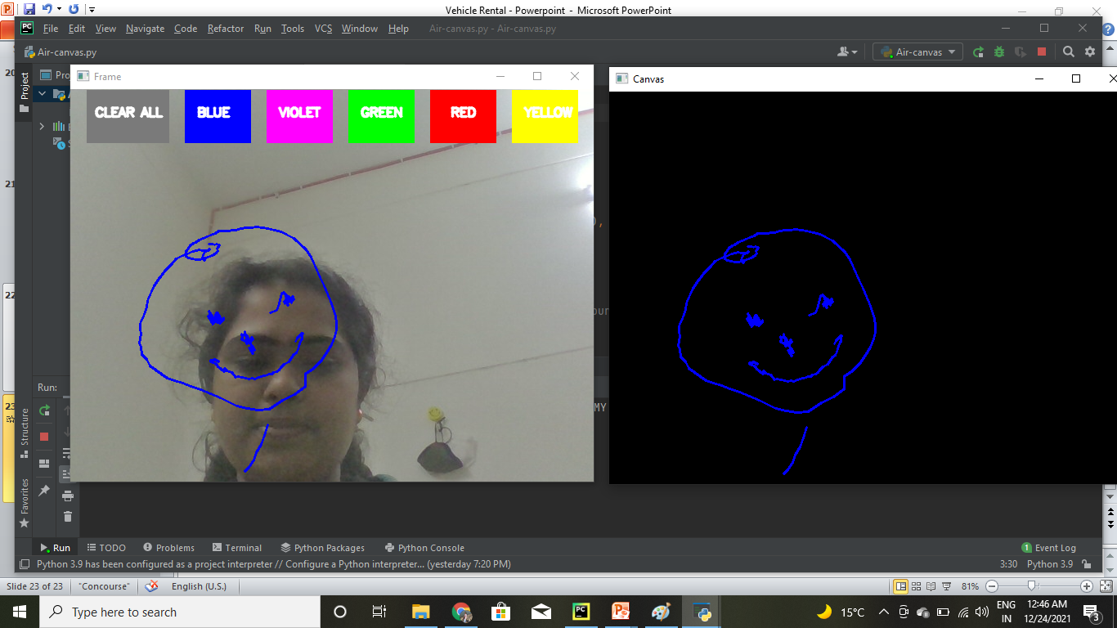

Slide 12
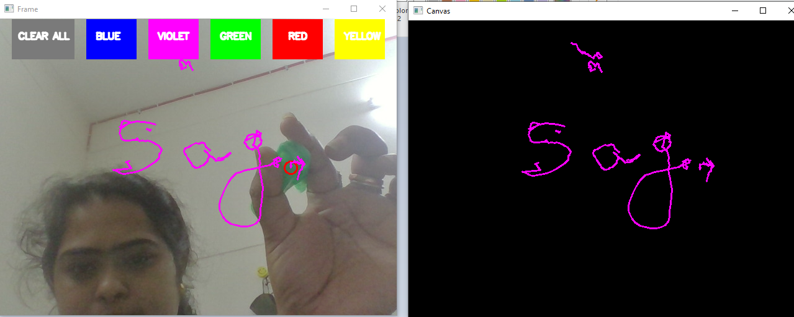

Slide 13
Thank You!

